Slide 1
Cryptography
Dr. Sara Qaisar

Slide 2
Decipher

Slide 3


Affine Cipher
The Affine cipher is a type of mono-alphabetic substitution cipher, wherein each letter in an alphabet is mapped to its numeric equivalent, encrypted using a simple mathematical function, and converted back to a letter
Encryption Function
Decryption Function
Here a and m must be coprime numbers

Slide 4
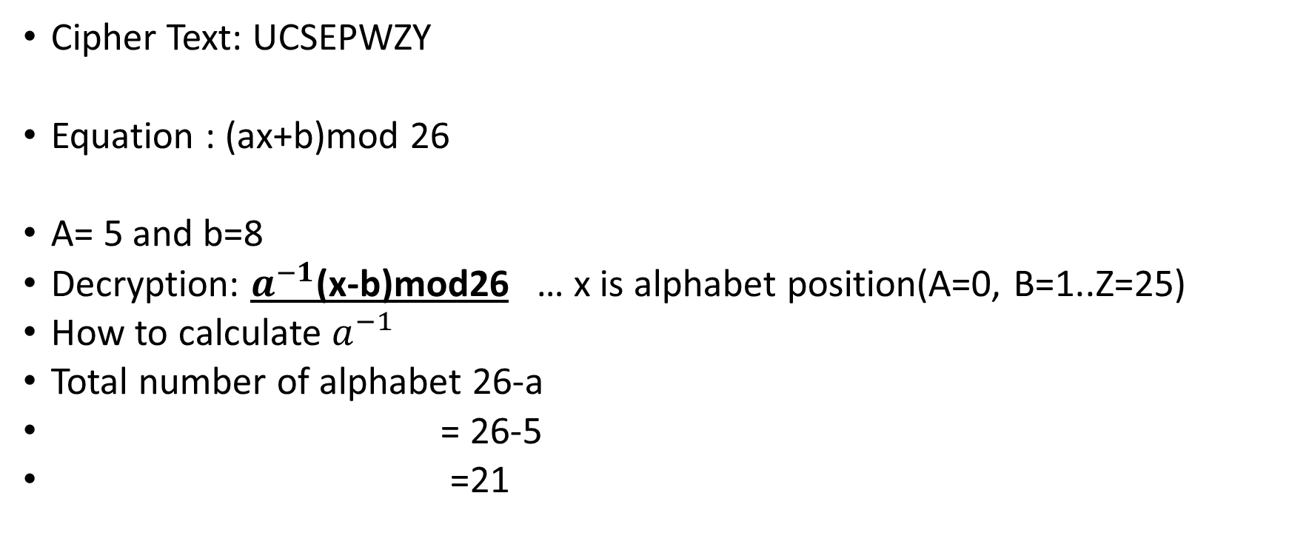
Decipher
Cipher Text: UCSEPWZY
Equation : (ax+b)mod 26
A= 5 and b=8
Decryption: $a^{−1}$(x-b)mod26 … x is alphabet position(A=0, B=1..Z=25)
How to calculate $a^{−1}$
Total number of alphabet 26-a
= 26-5
=21

Slide 5
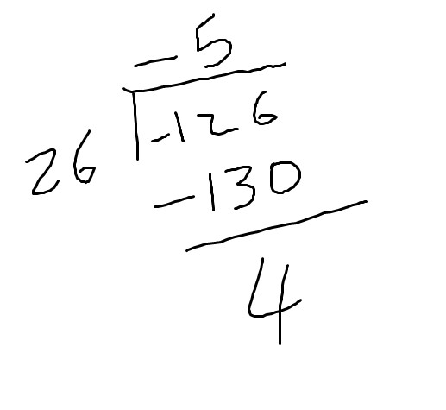
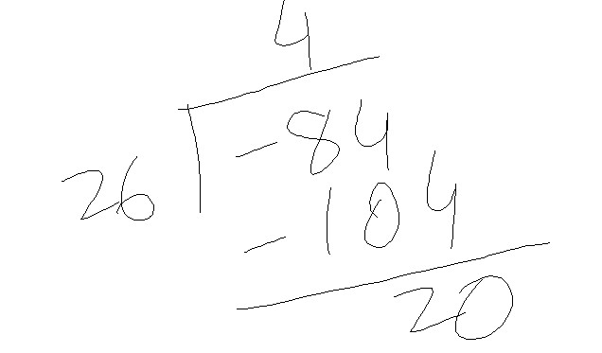

$a^{−1}$(x-b)mod26
21(20-8)mod26= 18= S
21(2-8)mod26= -4= E
21(18-8)mod26=2=C
21(4-8)mod26=20= U

Slide 6
How to calculate mod 26
First divide the number by 26
Minus the value before decimal point
Then multiply by 26
The answer will be remainder.
For example
210 mod 26
210/ 26 = 8.07
-8
Then multiple by 26
The remainder is 2

Slide 7
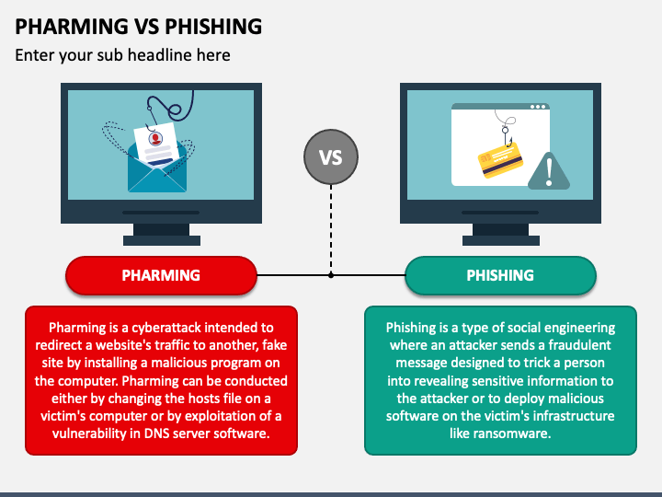

Slide 8
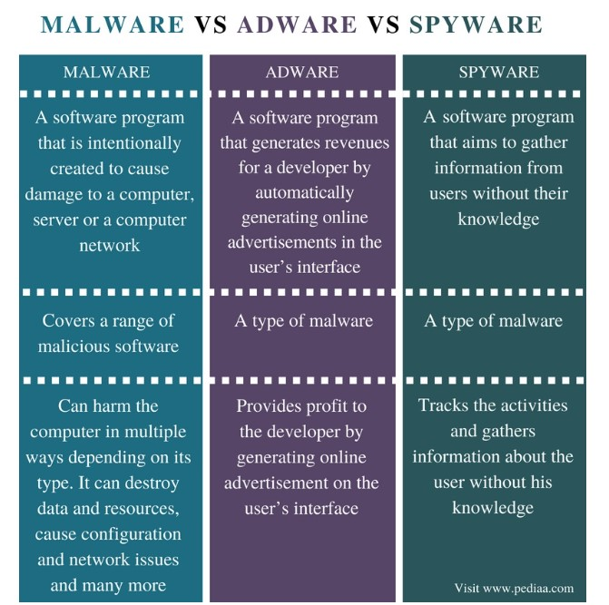

Slide 9
Block and Stream Cipher

Slide 10

Another variation in cryptographic algorithms is the amount of data that is processed at a time. Some algorithms use a stream cipher that takes one character and replaces it with one character.
Other algorithms make use of a block cipher.
Whereas a stream cipher works on one character at a time, a block cipher manipulates an entire block of plaintext at one time.
The plaintext message is divided into separate blocks of 8 to 16 bytes, and then each block is encrypted independently. For additional security, the blocks can be randomized.
Recently a third type has been introduced called a sponge function.
A sponge function takes as input a string of any length, and returns a string of any requested variable length.
This function repeatedly applies a process on the input that has been padded with additional characters until all characters are used (absorbed in the sponge).

Slide 11
Block vs. Stream Ciphers
A stream cipher is one that encrypts a digital data stream one bit or one byte at a time.
Examples of classical stream ciphers are the autokeyed Vigenère cipher and the Vernam cipher.
The bit-stream generator must be implemented as an algorithmic procedure, so that the cryptographic bit stream can be produced by both users.
A block cipher is one in which a block of plaintext is treated as a whole and used to produce a ciphertext block of equal length.
Examples of block ciphers are DES, AES.
The two users share a symmetric encryption key

Slide 12
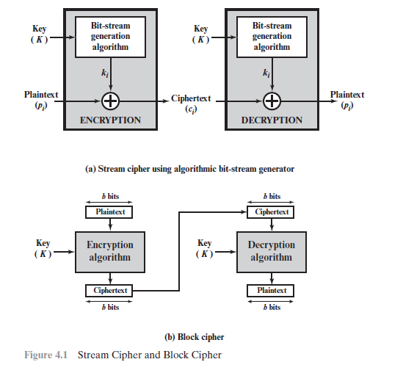
Block vs. Stream Ciphers

Slide 13
Block Cipher Principles
Most symmetric block ciphers are based on a Feistel Cipher Structure
Basic requirement is that it must be able to decrypt ciphertext to recover messages efficiently
For n bits block there must be 2^n possible different plaintext blocks and for the encryption it should be reversible
Block ciphers look like an extremely large substitution
Would need table of 2^64 entries for a 64-bit block, instead of to create from smaller building blocks

Slide 14
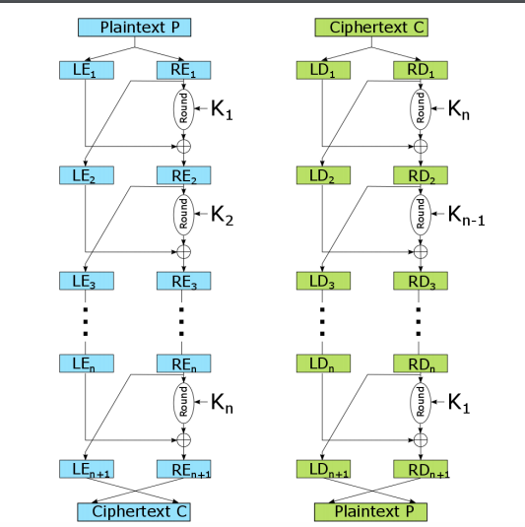
Fiestel Structure

Slide 15
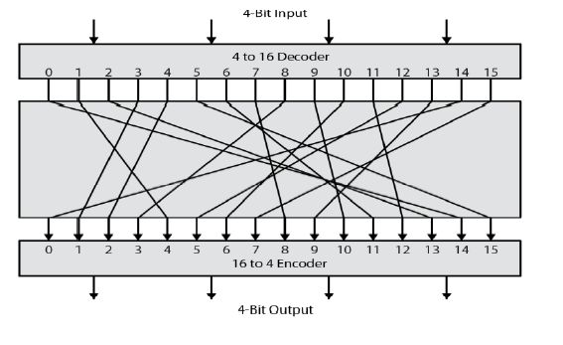
Ideal Block Cipher

Slide 16
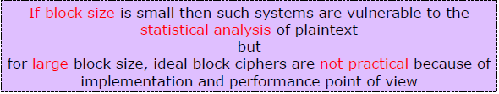
Block Size

Slide 17
Symmetric Cryptographic Algorithms
Symmetric cryptographic algorithms use the same single key to encrypt and decrypt a document.
Unlike hashing, in which the hash is not intended to be decrypted, symmetric algorithms are designed to encrypt and decrypt the ciphertext.
Data encrypted with a symmetric cryptographic algorithm by Alice will be decrypted when received by Bob.
It is therefore essential that the key be kept private (confidential), because if an attacker obtained the key he could read all the encrypted documents.
For this reason, symmetric encryption is also called private key cryptography.

Slide 18
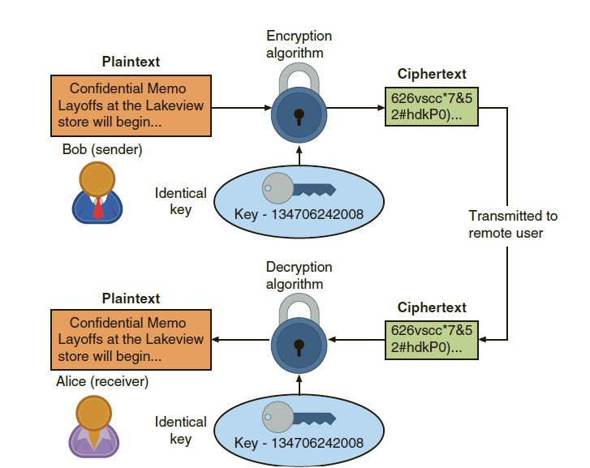

Slide 19
Common symmetric cryptographic algorithms include the
Data Encryption Standard
Triple Data Encryption Standard
Advanced Encryption Standard
Data Encryption Standard (DES)
The predecessor of DES was a product originally designed in the early 1970s by IBM called Lucifer that had a key length of 128 bits.
The key was later shortened to 56 bits and renamed DES. Although DES was once widely implemented, its 56-bit key is no longer considered secure and has been broken several times.
Triple Data Encryption Standard
3DES uses three rounds of encryption instead of just one. The ciphertext of one round becomes the entire input for the second iteration. 3DES employs a total of 48 iterations in its encryption (3 iterations times 16 rounds). The most secure versions of 3DES use different keys for each round.

Slide 20
Advance Encryption Standard (AES)
AES performs three steps on every block (128 bits) of plaintext. Within step 2, multiple rounds are performed depending upon the key size: a 128-bit key performs 9 rounds, a 192-bit key performs 11 rounds, and a 256-bit key, known as AES-256, uses 13 rounds.
Within each round, bytes are substituted and rearranged, and then special multiplication is performed based on the new arrangement. To date, no attacks have been successful against AES.

Slide 21
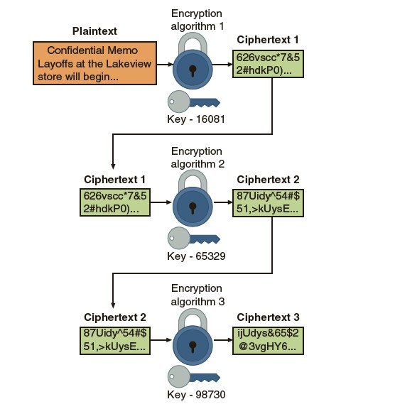

Slide 22
Advanced Encryption Standard
This standard specifies the Rijndael algorithm
It is a symmetric block cipher that can process data blocks of 128 bits
Rijndael was designed to handle additional block sizes
Cipher keys with lengths of 128, 192, and 256 bits.
The algorithm may be used with the three different key lengths indicated above, and therefore these different “flavors” may be referred to as
AES-128
AES-192
AES-256

Slide 23
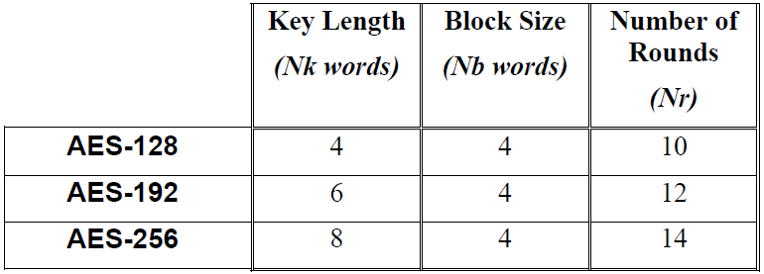
AES Algorithm

Slide 24
AES Round
For Cipher, the AES algorithm uses a round function that is composed of four different byte-oriented transformations:
byte substitution using a substitution table (S-box)
shifting rows of the State array by different offsets
mixing the data within each column of the State array
Adding a Round Key to the State.

Slide 25
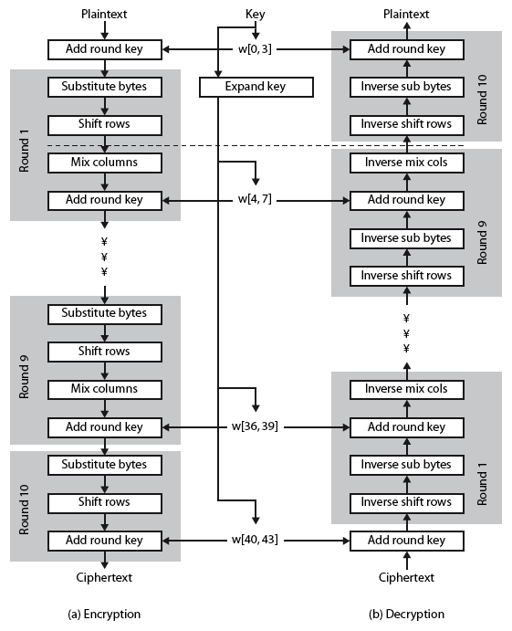
AES: Rijndael

Slide 26
Byte Substitution
A simple substitution of each byte
Uses one table of 16x16 bytes containing a permutation of all 256 8-bit values
Each byte of state is replaced by byte indexed by row (left 4-bits) & column (right 4-bits)
eg. byte {95} is replaced by byte in row 9 column 5
which has value {2A}
Designed to be resistant to all known attacks

Slide 27
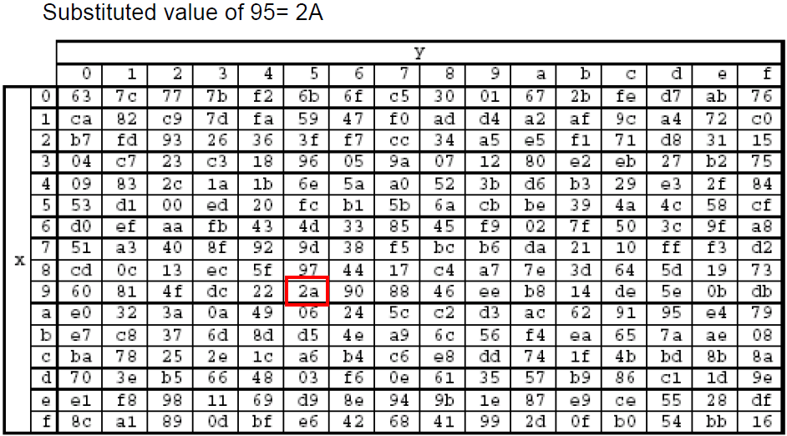
Substitution Box

Slide 28
Shift Rows
A circular byte shift in each row
1st row is unchanged
2nd row does 1 byte circular shift to left
3rd row does 2 byte circular shift to left
4th row does 3 byte circular shift to left
Since state is processed by columns, this step permutes bytes between the columns

Slide 29
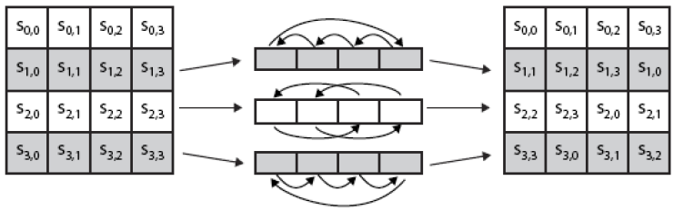
Shift Rows

Slide 30

Mix Column
Each column is processed separately
Each byte is replaced by a value dependent on all 4 bytes in the column

Slide 31
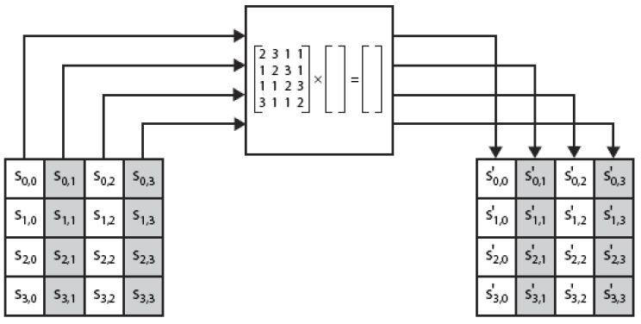
Mix Column

Slide 32
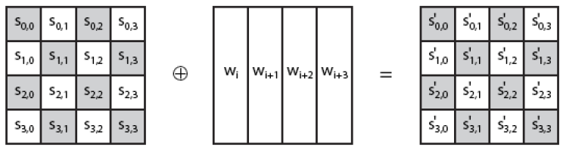
Add Round Key
XOR state with 128-bits of the round key
Again processed by column (though effectively a series of byte operations)
Designed to be as simple as possible

Slide 33
Example
Plain Text: 1101 0111 0010 1000
Key : 0100 1010 1111 0101
Split the key: 0100 1010 = w0
1111 0101 = w1
1100 1101 = w2
1010 1110=w3
First step: Plain Text XoR with Key
⊕ =
1101 | 0111
0010 | 1000
0100 | 1010
1111 | 0101
1001 | 1101
1101 | 1101

Slide 34
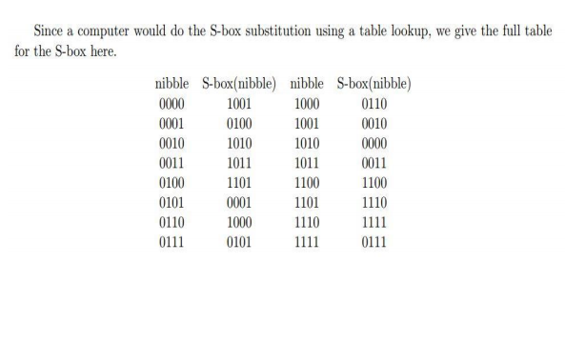
Example
Second step is Nibble substitution:
=
Third step is row shifting:
1001 | 1101
1101 | 1101
0010 | 1110
1110 | 1110
0010 | 1110
1110 | 1110

Slide 35

Fourth step is shift Column
⊕ $\left[\begin{matrix}1 & 4 \\ 4 & 1\end{matrix}\right]$
= $\left[\begin{matrix}1 & x2 \\ x2 & 1\end{matrix}\right]$
Equations are :
0010 ⊕ (4 x 1110)
(4 x 0010) ⊕ 1110
1110 ⊕ (4 x 1110)
(4 x 1110) ⊕ 1110
0010 | 1110
1110 | 1110

Slide 36
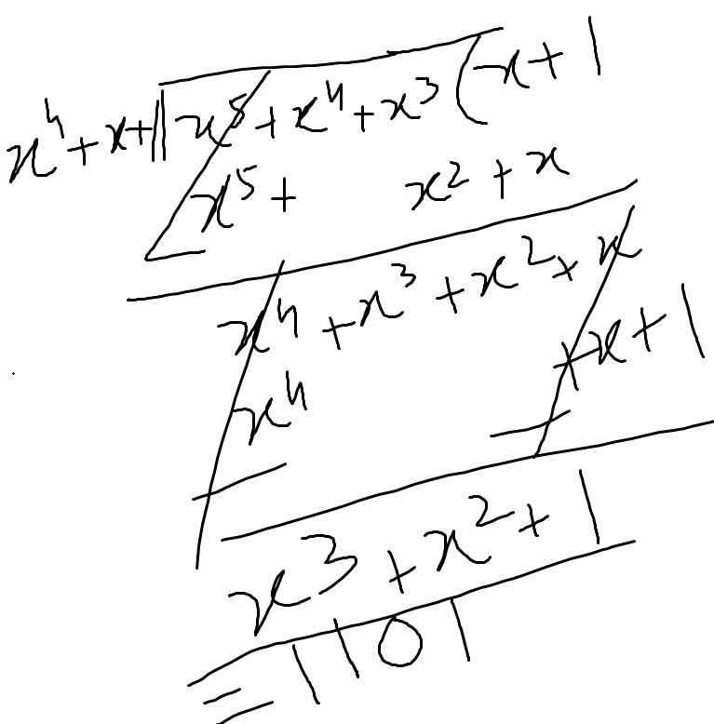
Shift Column
0010 * (4 x 1110)
=(x2 * x3+x2+x)
= (x5+ x4+x3) (reducible to x4+x+1)
0010 | 1110
1110 | 1110
1111 | 0011
0011 | 0011

Slide 37
Equations are :
0010 ⊕ (4 x 1110)
0010 ⊕ 1101 = 1111
(4 x 0010) ⊕ 1110
1000 ⊕ 1110 = 0110
1110 ⊕ (4 x 1110)
1110 ⊕ 1101 = 0011
(4 x 1110) ⊕ 1110
1101 ⊕ 1110= 0011

Slide 38
Add round key
w2=w0 x w1
= 1111 0101 xor 1000 0010
⊕ =
1111 | 0110
0011 | 0011
1111 | 0101
1000 | 0010
0000 | 0011
1011 | 0001

Slide 39
Thanks

